Slide 1


AGE 316
MICROCOMPUTER SYSTEMS
LECTURE 8: BASIC SENSOR INTERFACING
Dr. Kadeghe Fue
Department of Agricultural Engineering

Slide 2



Recap: What we know
Digital I/O: ON/OFF signals (LEDs, Buttons).
Analog I/O: Reading varying voltages (0-5V).
Serial: Talking to the computer for debugging.
Today:
Sensors

Slide 3









Concept: The Transducer
A sensor is a device that converts a Physical Quantity (Light, Heat, Motion) into an Electrical Signal (Voltage, Resistance).
Physical
Sensor
Electrical
Light / Temp
Transducer
Voltage (V)

Slide 4



Types of Sensors
1. Digital Sensors
2. Analog Sensors
Output is binary: HIGH (5V) or LOW (0V).
Output is a continuous range of voltage.
•
Motion Detected? Yes/No
•
Temperature: 24.5°C
•
Door Open? Yes/No
•
Light Intensity: 75%
•
Button Pressed? Yes/No
•
Soil Moisture: 400 units

Slide 5
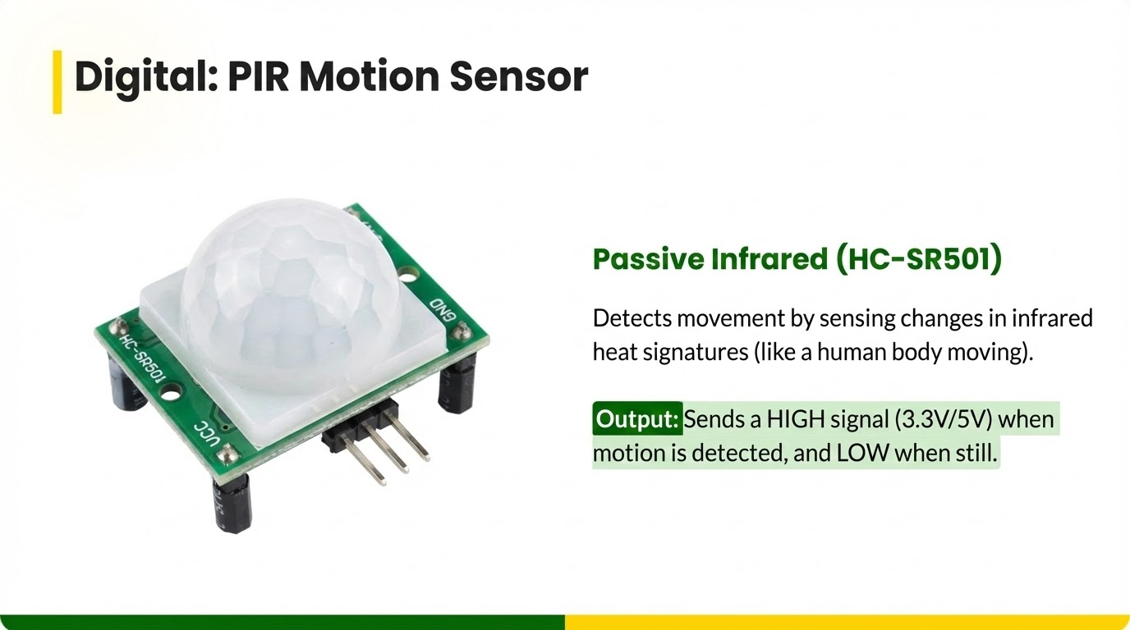

Slide 6


Wiring the PIR
Steps:
VCC ------> 5V (Arduino)
OUT ------> Pin 2 (Arduino)
GND ------> GND (Arduino)
1.
Remove the white dome (optional, to see sensor).
2.
Locate the 3 pins (often labelled under the dome).
3.
Connect Output to any Digital Pin (e.g., D2).
4.
Adjustments: Orange pots control Sensitivity (Distance) and Delay Time.

Slide 7


Code: Reading PIR
Since it's digital, we use digitalRead().
int
2
int
0
void
setup
pinMode
INPUT
Serial.begin
void
loop
digitalRead
if
HIGH
Serial.println
"Motion Detected!"

Slide 8
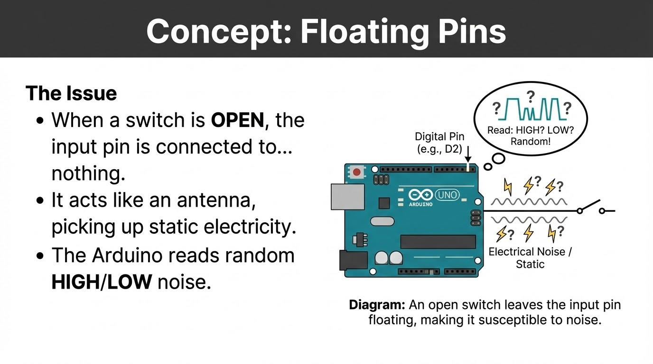

Slide 9




The Solution: Pull-up Resistor
We need to force the pin to a known state (HIGH) when the button is open.
Internal Pull-up
5V
Arduino has built-in 20k resistors we can activate!
pinMode
INPUT_PULLUP
Now: Default = HIGH. Pressed = LOW.
Pin 2

Slide 10
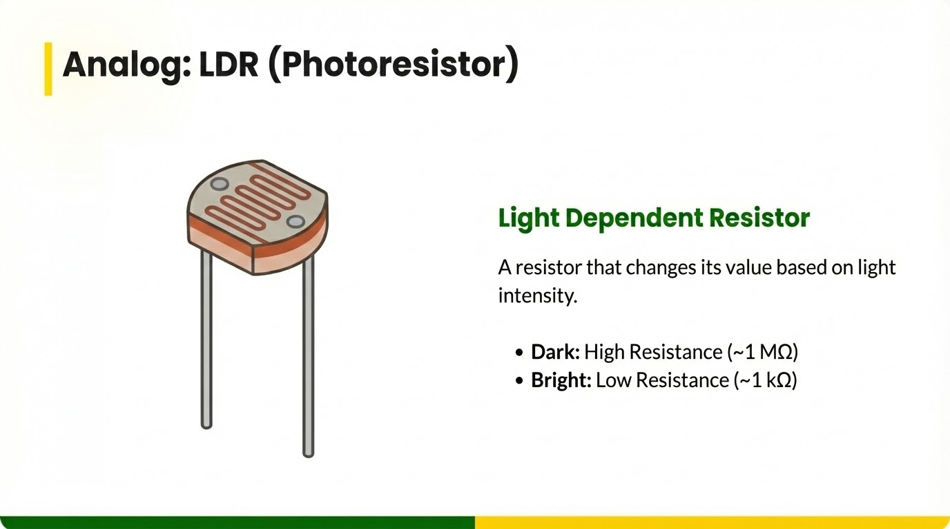

Slide 11
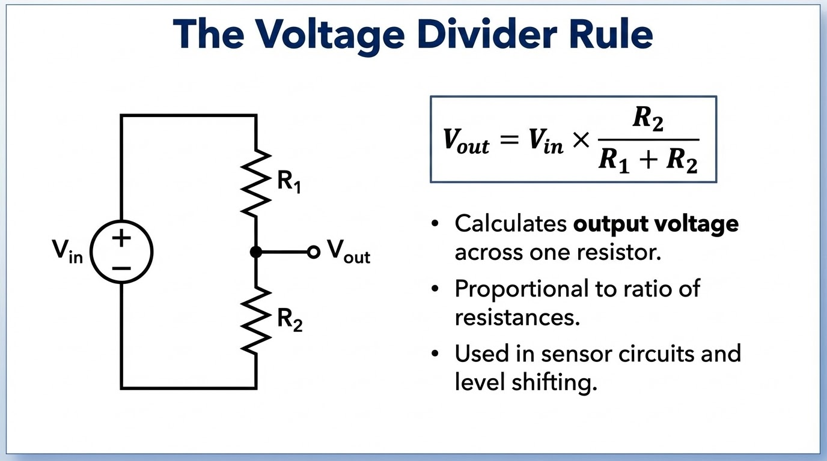

Slide 12
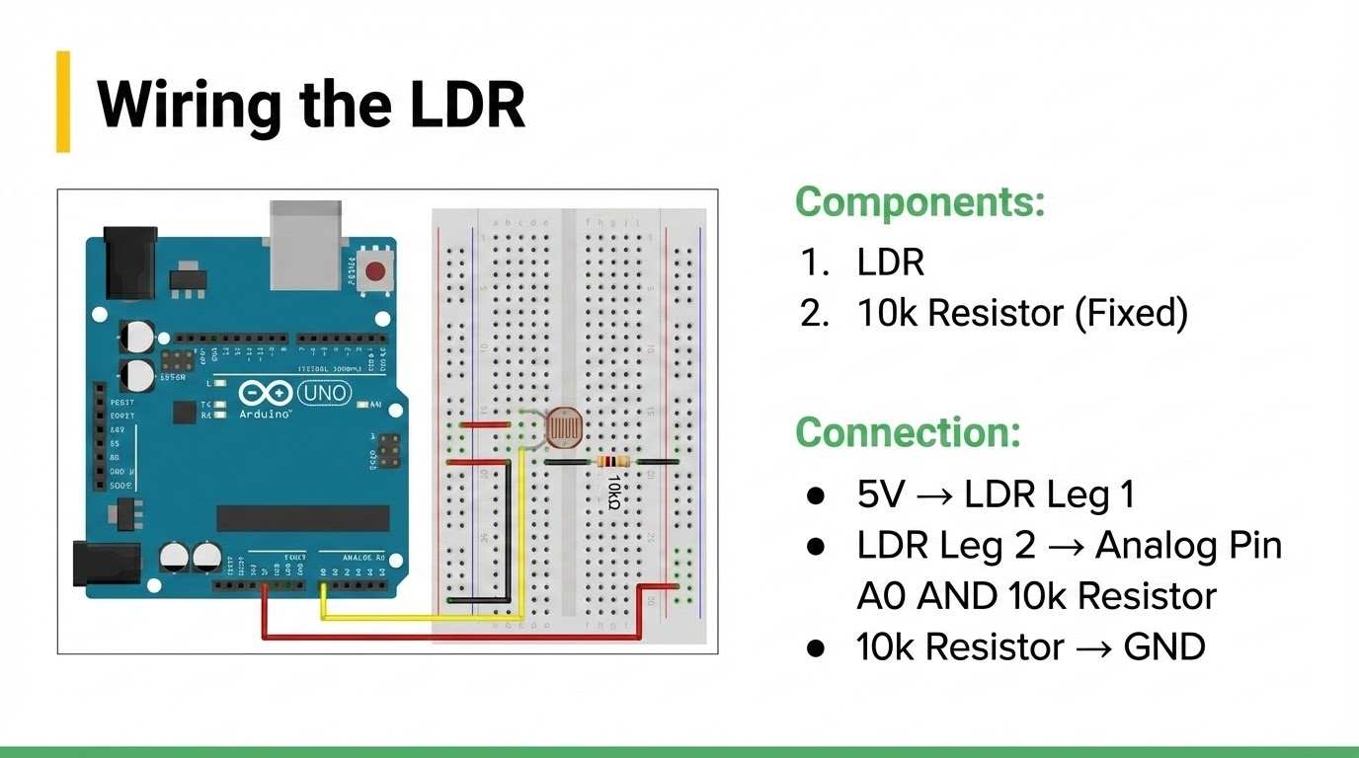

Slide 13


Code: Reading Light
We use analogRead() to get a value between 0 and 1023.
void
setup
Serial.begin
void
loop
int
analogRead
Serial.print
"Light Level: "
Serial.println
delay

Slide 14
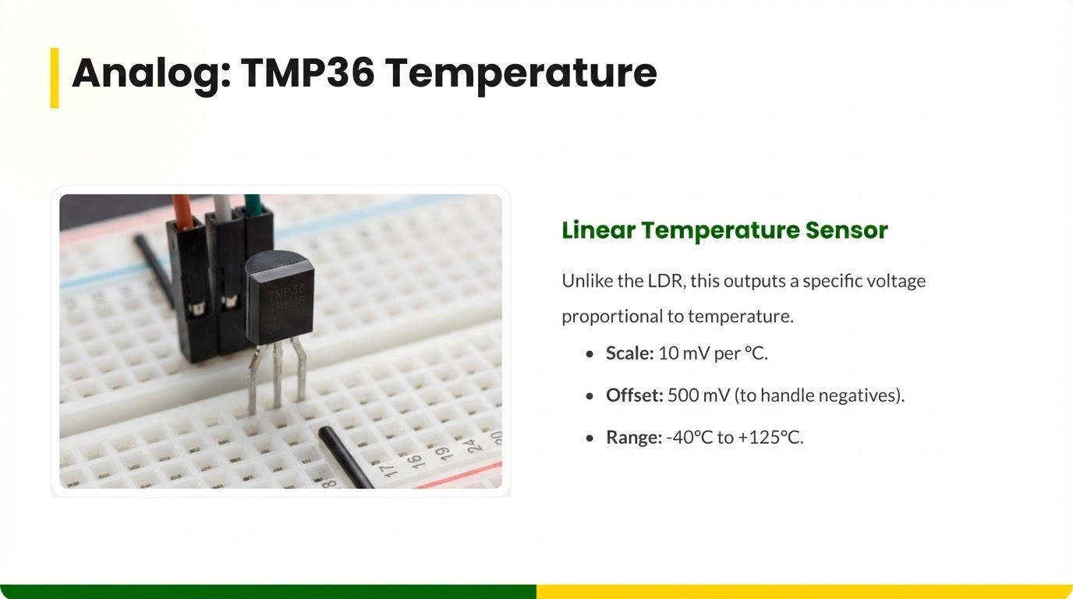

Slide 15
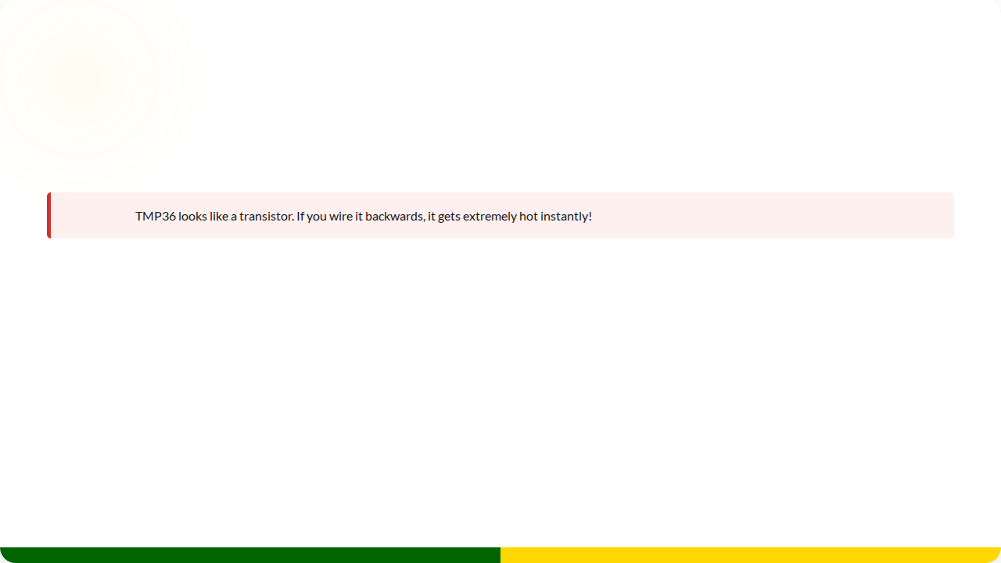



Wiring TMP36
WARNING:
Pin 1 (Left)
Pin 2 (Middle)
Pin 3 (Right)
Vs (2.7 - 5.5V)
Vout (To Analog A0)
GND
(When looking at the flat face with writing)

Slide 16

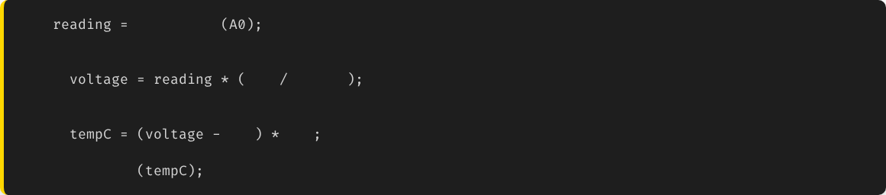
The Math: Bits to Celsius
int
analogRead
// 0 to 1023
// 1. Convert to Voltage (0 - 5V)
float
5.0
1024.0
// 2. Convert Voltage to Temp (10mV/C, 0.5V offset)
float
0.5
100
Serial.println

Slide 17

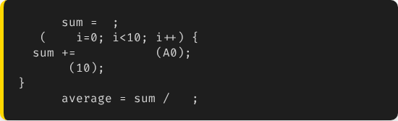
Concept: Signal Conditioning
Sensors are noisy. The readings jump around.
The Solution (Averaging)
Read the sensor 10 times and calculate the average.
The Problem
Raw Data: 24.1, 24.8, 23.9, 25.1, 24.0
float
0
for
int
analogRead
delay
float
10

Slide 18

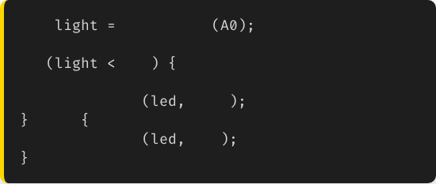
Project: Smart Night Light
The Logic
Combine LDR (Input) with LED (Output).
int
analogRead
if
300
// It's Dark!
digitalWrite
HIGH
Automatic Automation!
else
digitalWrite
LOW

Slide 19





Summary
Sensors
Divider
Math
Convert physical world to electrical signals.
Voltage Divider is needed for resistive sensors (LDR).
Raw 0-1023 data usually needs math to become useful units.

Slide 20


Questions?
"The only stupid question is the one you don't ask."
Dr. Kadeghe Fue
Sokoine University of Agriculture

